Slide 1
Introduction :
Toronto is not only a beautify city but also one of the most multi-cultural cities in the world . If you consider the demographics of Toronto , it has established ethnic neighborhoods such as Little India , Little Portugal etc that celebrates the city’s diversity and multi-culturalism . South Asians are approx. 12% of the total population they are scattered across the city of Toronto . The travel and tourism industry Toronto has been grown significantly with massive increase in number of Indians travelling to Toronto for business or for pleasure .
Business Problem :
The objective of this project is to recommend the “best” neighborhood in Toronto where people can explore “good” Indian cuisine or variety of ”good” Indian restaurants
Data Source :
We will use the Foursquare location and data and geographical cluster information to achieve this recommendation .
https://en.wikipedia.org/wiki/List_of_postal_codes_of_Canada:_M

Slide 2
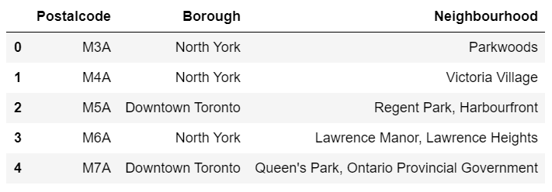
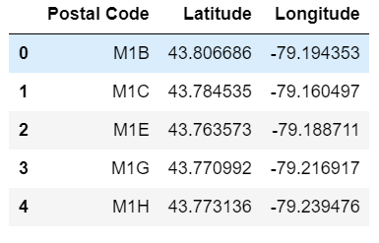
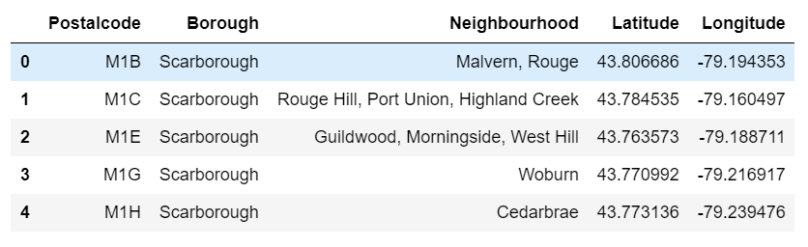
Data Extraction & Preparation :
Use Web scrapping technique to pull the postal code information for boroughs/neighbourhood in Toronto from Wikipedia page
Source - https://en.wikipedia.org/wiki/List_of_postal_codes_of_Canada:_M
Prepare the data and remove empty column values
Extract and manipulate the geospatial data for Toronto
Source - http://cocl.us/Geospatial_data
Finally merge the 2 data set to create one single data set

Slide 3
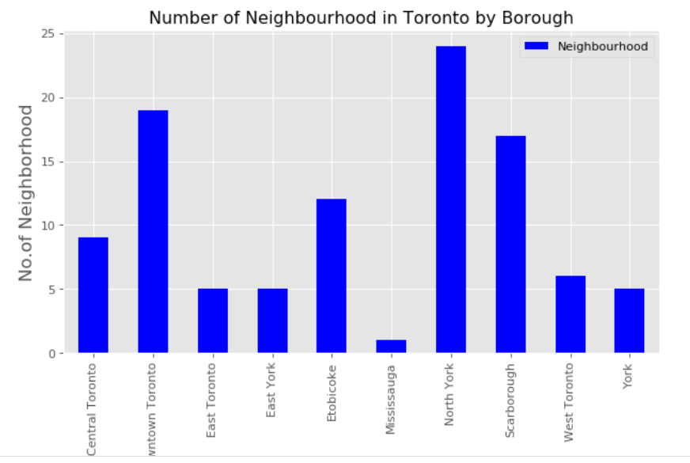
Exploratory Analysis :
North York is the most densely populated borough with 24 neighborhood
There are a total of 103 different neighborhoods in Toronto

Slide 4
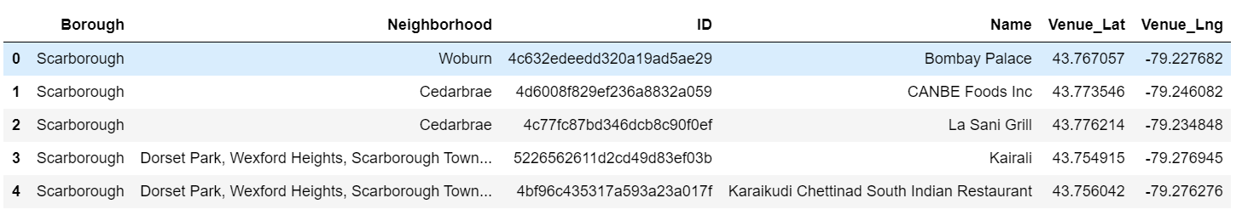
Four Square API :
Provide Credentials (CLIENT_ID, CLIENT_SECRET, VERSION)
Define function to fetch data from Foursquare API . This function will get top 100 venues within a radius of 1000 miles for a given latitude and longitude
We know that there are a total of of 103 different neighborhoods in Toronto
Build a Logic to get the list of neighborhoods that have Indian restaurant

Slide 5
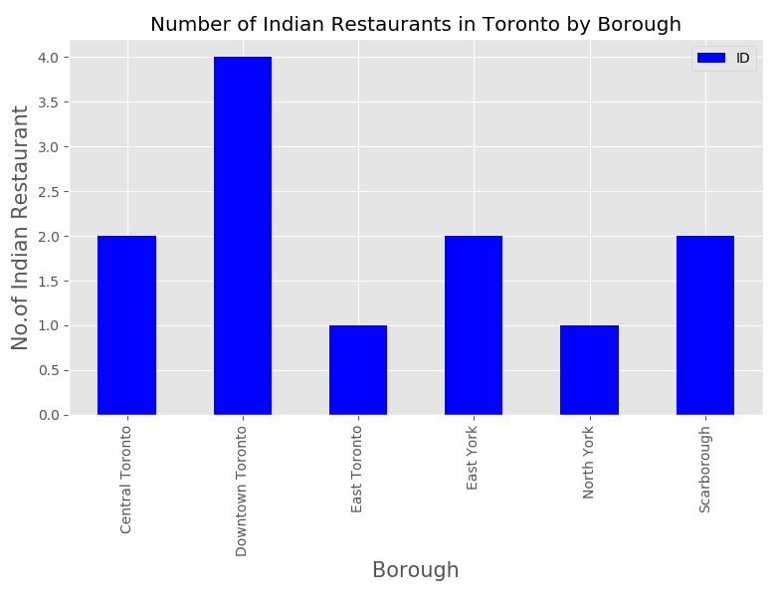
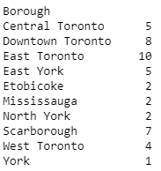
Analysis :
East Toronto has the maximum number of Indian Restaurants

Slide 6
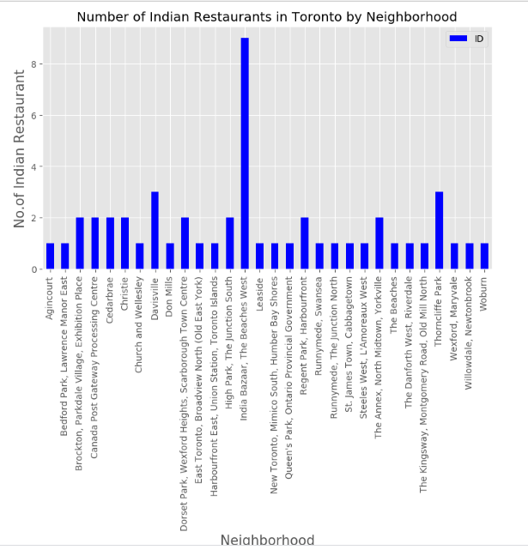
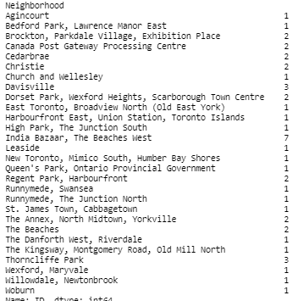
Analysis :
India Bazaar , The Beaches West has the maximum number of Indian Restaurants

Slide 7
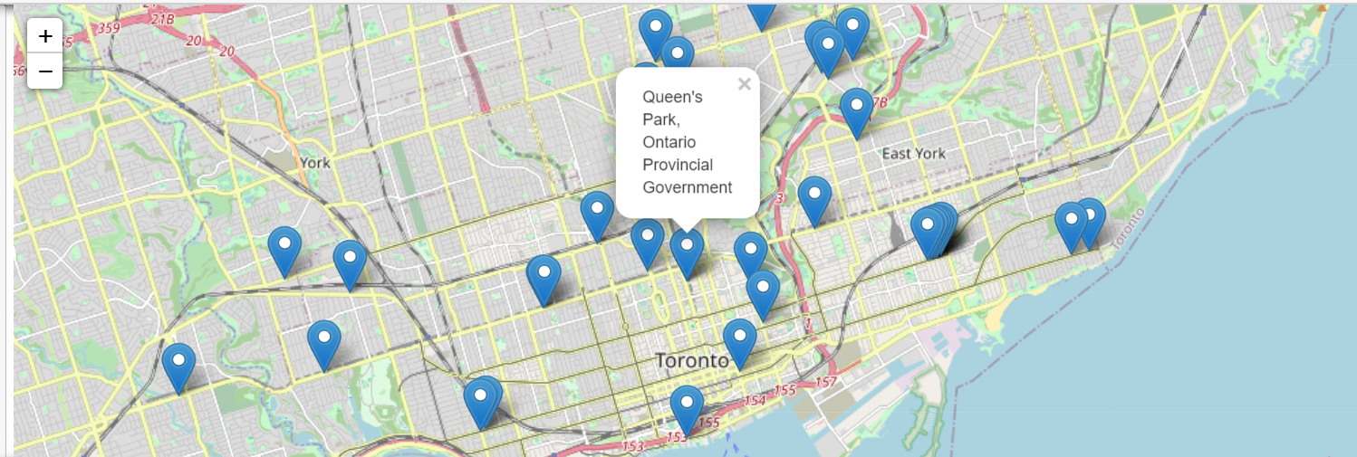
Visualize & Recommend :
North York Neighborhood and India Bazaar , The Beaches West borough have the maximum number of Indian Restaurants and can be recommended as first choice of visit to explore various Indian cuisines

